Slide 1

Introduction to Trans and Gender Diverse Identities

Slide 2

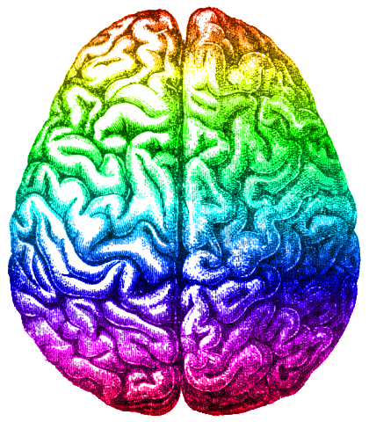

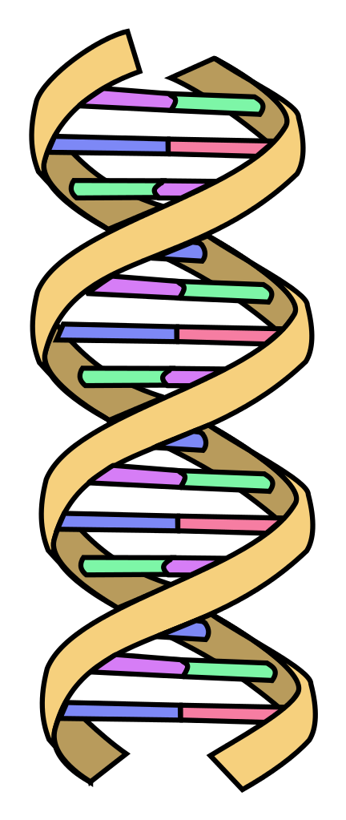
What is gender?
Gender Identity:
How people interpret and view themselves, within the context of wider society and culture.
A person’s sex, gender identity, and gender expression may vary and not correspond
Gender Expression:
How people present themselves.
People might present as feminine, masculine, neutral or a combination, and this may vary.
Sex: The biological characteristics of a person’s body, i.e. organs and DNA.
Usually this is male, female, or intersex.

Slide 3


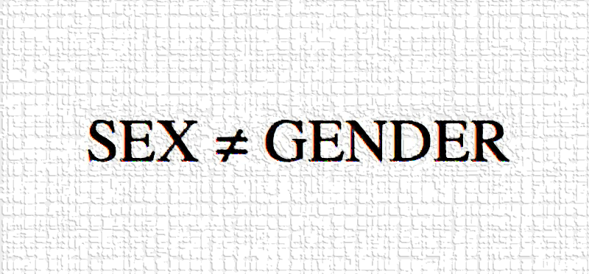
Gender identity vs. Assigned gender
Gender Identity:
Gender is how people interpret and view themselves. A person might identify as the gender they were assigned at birth (cisgender) or they may identify differently (transgender).
Gender is assigned at birth based on physical sex – i.e. It’s a girl! or It’s a boy! – and people are generally raised in this gender role.
This is called assigned gender.

Slide 4

Gender identity also differs from sexual orientation…
Sexual and Romantic Attraction:
Who you are sexually and/or romantically attracted to.
Sexual orientations can include heterosexual, lesbian, gay, bisexual, queer, and asexual.
Trans status is not the same as sexuality. For example, you can be trans and heterosexual, or you can be trans and gay.

Slide 5




So what is trans?
The term transgender – or trans – refers to people who do not fully identify with the gender and / or sex they were assigned at birth. In simple terms, this can include:
Non-binary and gender diverse people experience their gender identity as outside of the binary of man and woman
I’m a woman, and I was assigned male at birth.
I’m a man, and I was assigned female at birth.
Trans Women
Trans Men
Non-Binary people
Gender diverse people

Slide 6
So what is cisgender?
The opposite of transgender
Term for people whose gender identity matches the gender they were assigned at birth
Non-pejorative term (in our usage)
Allows for discussion of gender and difference without using problematic language e.g. normal, usual…
Latin prefix meaning ‘on this side of’ in comparison to trans which means ’on the other side of’

Slide 7
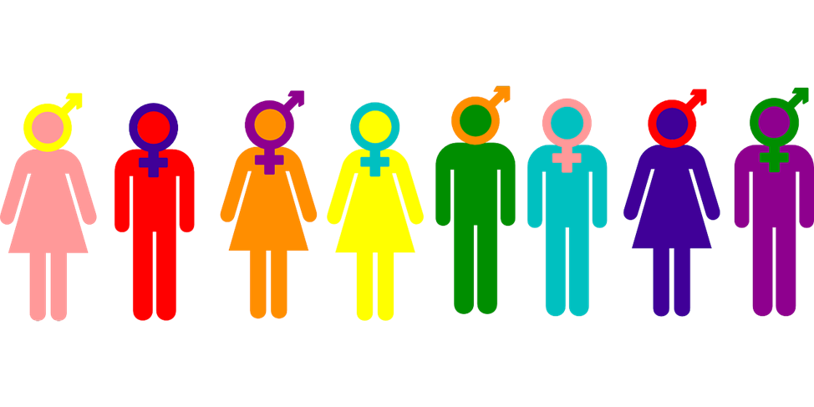
And what is gender diversity?
We use the term ‘gender diverse’ to refer to people who experience their gender identity outside of the binary of male and female. This term is also useful for people who are questioning or unsure about their gender identity.
We use this term in addition to ‘trans’ because some non-binary, genderqueer, agender, and gender-variant people do not use the term ‘trans’ to describe their identities.

Slide 8
Identity terms
There are many identity terms that trans and gender diverse people may use.
(Trans) Woman
Agender
(Trans) Man
Non-Binary
Person with a trans history
Genderqueer
Person of trans experience
There’s no need to learn them all – just have an open, compassionate and respectful approach.
Transgender
Transsexual

Slide 9
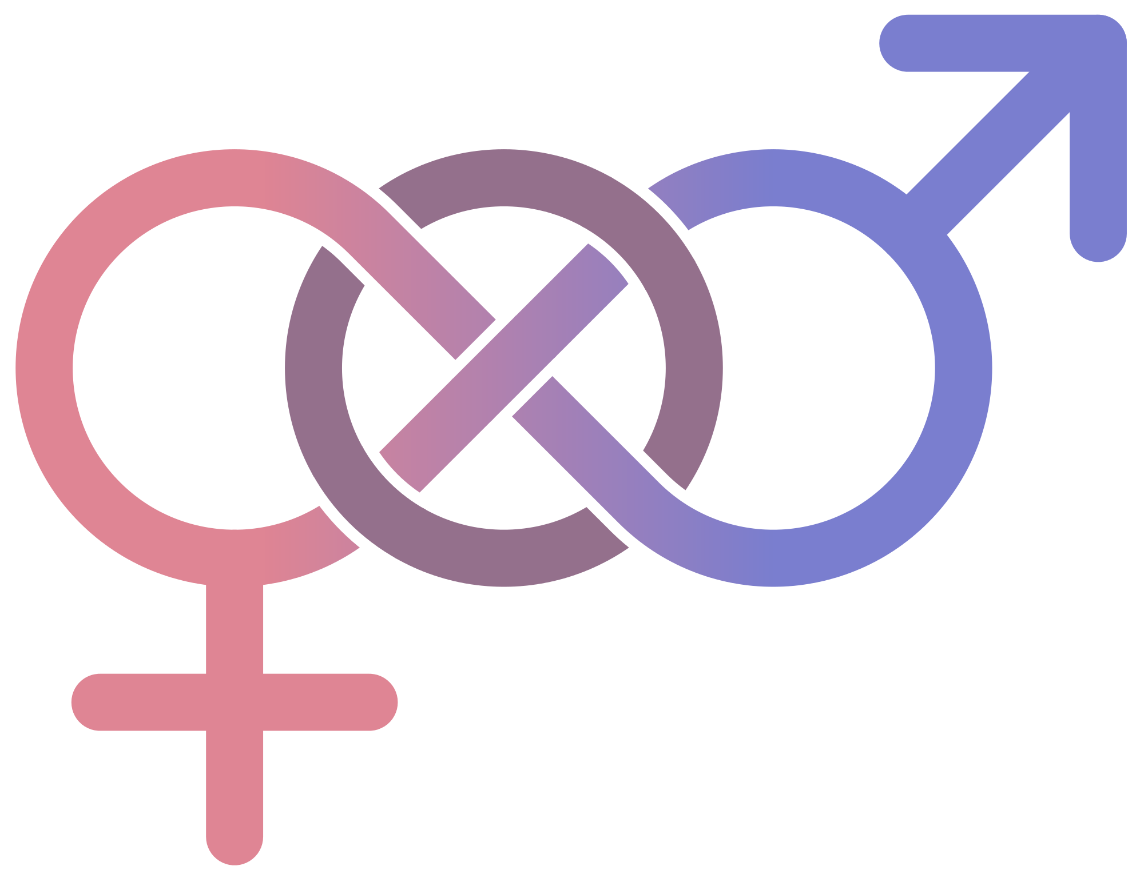
Is ‘intersex’ different?
Yes it is! Intersex refers to people who are born with primary sex characteristics – such as genitals and chromosome patterns – that do not fit typical binary notions of male and female.
This is about chromosomal or physical sex and not gender identity.
Some intersex people might be trans or gender diverse, while other intersex people might identify with the gender they were assigned at birth.
Specific provision and support for intersex people is required, as needs and circumstances often differ from those of trans and gender diverse people.

Slide 10
What is ‘transitioning’?
Transitioning is when a person takes steps to socially and /or physically feel more aligned with their gender identity.
Social Transition
Physical Transition
Social transition refers to social interactions and processes, such as ‘coming out’ as trans to yourself and your friends, family and peers.
It can also involve changes to:
Name, pronouns and language
How you use gendered spaces and services
Documentation and identification
Physical transition can involve making changes to your appearance, gender presentation and gender expression.
It can also involve access to medical interventions, such as:
Hormone therapy
Hair removal
Voice therapy
Surgeries
Each person’s experience of transition is different …and not everyone uses the term ‘transition’!

Slide 11

Gender dysphoria
Gender dysphoria is an intense discomfort or distress a trans or gender diverse person may feel about their physical attributes and about how they are gendered by other people.
This discomfort or distress is often characterised as a mismatch between physical sex and gender identity.
‘Gender dysphoria’ is currently the clinical diagnosis given to trans and gender diverse people seeking medical treatment.

Slide 12

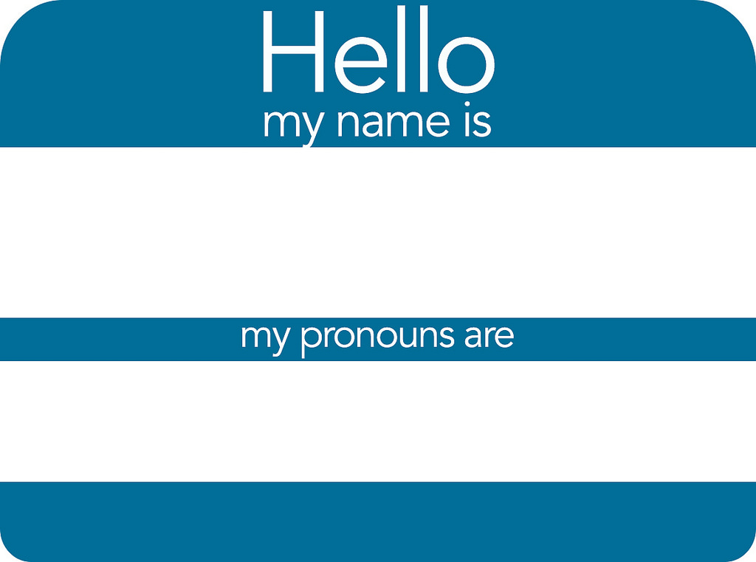
Pronouns
Pronouns are the terms we use to refer to each other, such as:
He / Him / His She / Her / Hers They / Them / Theirs Ze/Hir/Hirs
Matson
He / Him
Take time to learn and use people’s correct pronouns.

Slide 13
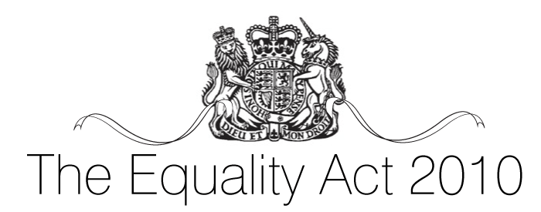
What the law says
The main legislation for the education sectors is the Equality Act 2010. The Act prohibits discrimination on the grounds of the ‘protected characteristic’ of ‘gender reassignment’, defined as:
A person has the protected characteristic of gender reassignment if the person is proposing to undergo, is undergoing or has undergone a process (or part of a process) for the purpose of reassigning the person's sex by changing physiological or other attributes of sex. (Equality Act 2010)

Slide 14
‘Gender reassignment’..?
As clarified by the Equality and Human Rights Commission’s Technical Guidance for FE and HE:
‘Under the Act ‘gender reassignment’ is a personal process, (that is, moving away from one’s birth sex to the preferred gender), rather than a medical process’
‘It may include undergoing the medical gender reassignment treatments, but it does not require someone to undergo medical treatment in order to be protected’
‘This broad, non-medical definition is particularly important for gender variant young people […] they may have begun a personal process of changing their gender identity and be moving away from their birth sex. Manifestations of that personal process, such as mode of dress, indicate that a process is in place and they will be protected under the Act.’ (EHRC, 2014: 22)

Slide 15

Types of discrimination
The Equality Act 2010 sets out four main categories of discrimination:
Direct discrimination – Treating someone with a protected characteristic less favourably than others;
Indirect discrimination – Putting rules or arrangements in place that apply to everyone, but that put someone with a protected characteristic at an unfair disadvantage;
Harassment – Unwanted behaviour linked to a protected characteristic that violates someone’s dignity or creates an offensive environment for them;
Victimisation – Treating someone unfairly because they’ve complained about discrimination or harassment.
This also covers those who are perceived as having a certain protected characteristic and those who are associated with a person with a protected characteristic.

